Slide 1


Sales Prediction: Optimising B2B Sales Efficiency
Welcome to our presentation on optimising B2B sales efficiency through advanced sales prediction. This project introduces a machine learning model designed to revolutionise how sales teams forecast outcomes and prioritise high-potential opportunities.

Slide 2






Presentation Agenda
Introduction & Problem Statement
Project Overview
Data Insights
Model Development & Evaluation
Understanding B2B sales challenges and lead conversion inefficiencies.
Objective, scope, and methodology of our predictive lead conversion model.
Exploration, preprocessing, and feature engineering of the X Education dataset.
Building, training, and assessing the performance of our machine learning model.
Conclusion & Next Steps
Key takeaways and actionable recommendations for future implementation.

Slide 3



Addressing Lead Conversion Inefficiencies
In the competitive B2B landscape, significant investments are made in lead generation, yet a substantial portion of these leads fail to convert. This leads to inefficient resource allocation and suboptimal ROI. The core challenge is the absence of intelligent systems capable of identifying high-potential leads from past data and behavioural indicators.
High Investment, Low Return
Inefficient Resource Utilisation
Lack of Intelligent Prioritisation
Current lead generation efforts often result in poor conversion rates despite high investment.
Sales teams waste time and effort pursuing low-potential leads.
Absence of systems to effectively identify and rank leads based on their conversion probability.
Project Objective: Predictive Lead Conversion Model
Our primary objective is to develop a robust machine learning model that accurately predicts the probability of a lead converting into a customer. This model will classify leads into high, medium, and low potential categories, enabling sales teams to strategically prioritise their efforts, significantly improving conversion rates and overall sales effectiveness.
Automated Lead Scoring
Enhanced Sales Prioritisation
Improved Conversion Rates
Develop a system for dynamic lead classification.
Enable sales teams to focus on high-potential leads.
Increase the efficiency and success of sales efforts.

Slide 4

Project Scope & Methodology
This project encompasses the entire lifecycle of building a predictive model for lead conversion, from data acquisition to model deployment readiness. Our methodology is iterative, focusing on robust data processing, advanced model development, and rigorous evaluation to ensure practical applicability and measurable business impact.
Scope
Methodology
Data collection and integration from X Education.
Agile development cycles.
Comprehensive data cleaning and feature engineering.
Cross-validation for model training.
Development of machine learning models for lead prediction.
Iterative feature selection and refinement.
Regular stakeholder feedback and iteration.
Model evaluation and performance analysis.
Focus on explainability and interpretability of results.
Recommendations for CRM integration.

Slide 5
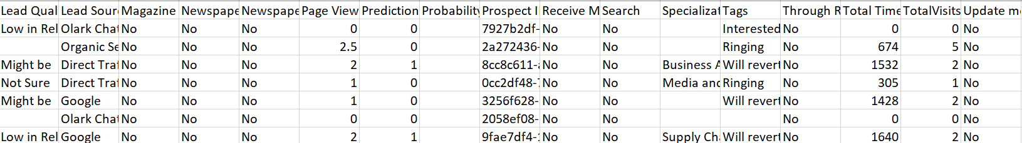
Dataset Overview: X Education
Our project leverages a comprehensive dataset from X Education, providing a rich source of information for lead analysis. The dataset includes a variety of features that capture lead behaviour, engagement, and demographic information, crucial for building an effective predictive model.
Key Features
Lead Origin: Source channel (e.g., web, referral, social media).
Activity: User interactions (e.g., website visits, form submissions).
Communication Preferences: Email, phone, preferred medium.
Time Spent on Website: User engagement metric.
Last Activity: Most recent interaction timestamp.
Lead Tags: Categorical labels assigned to leads.

Slide 6
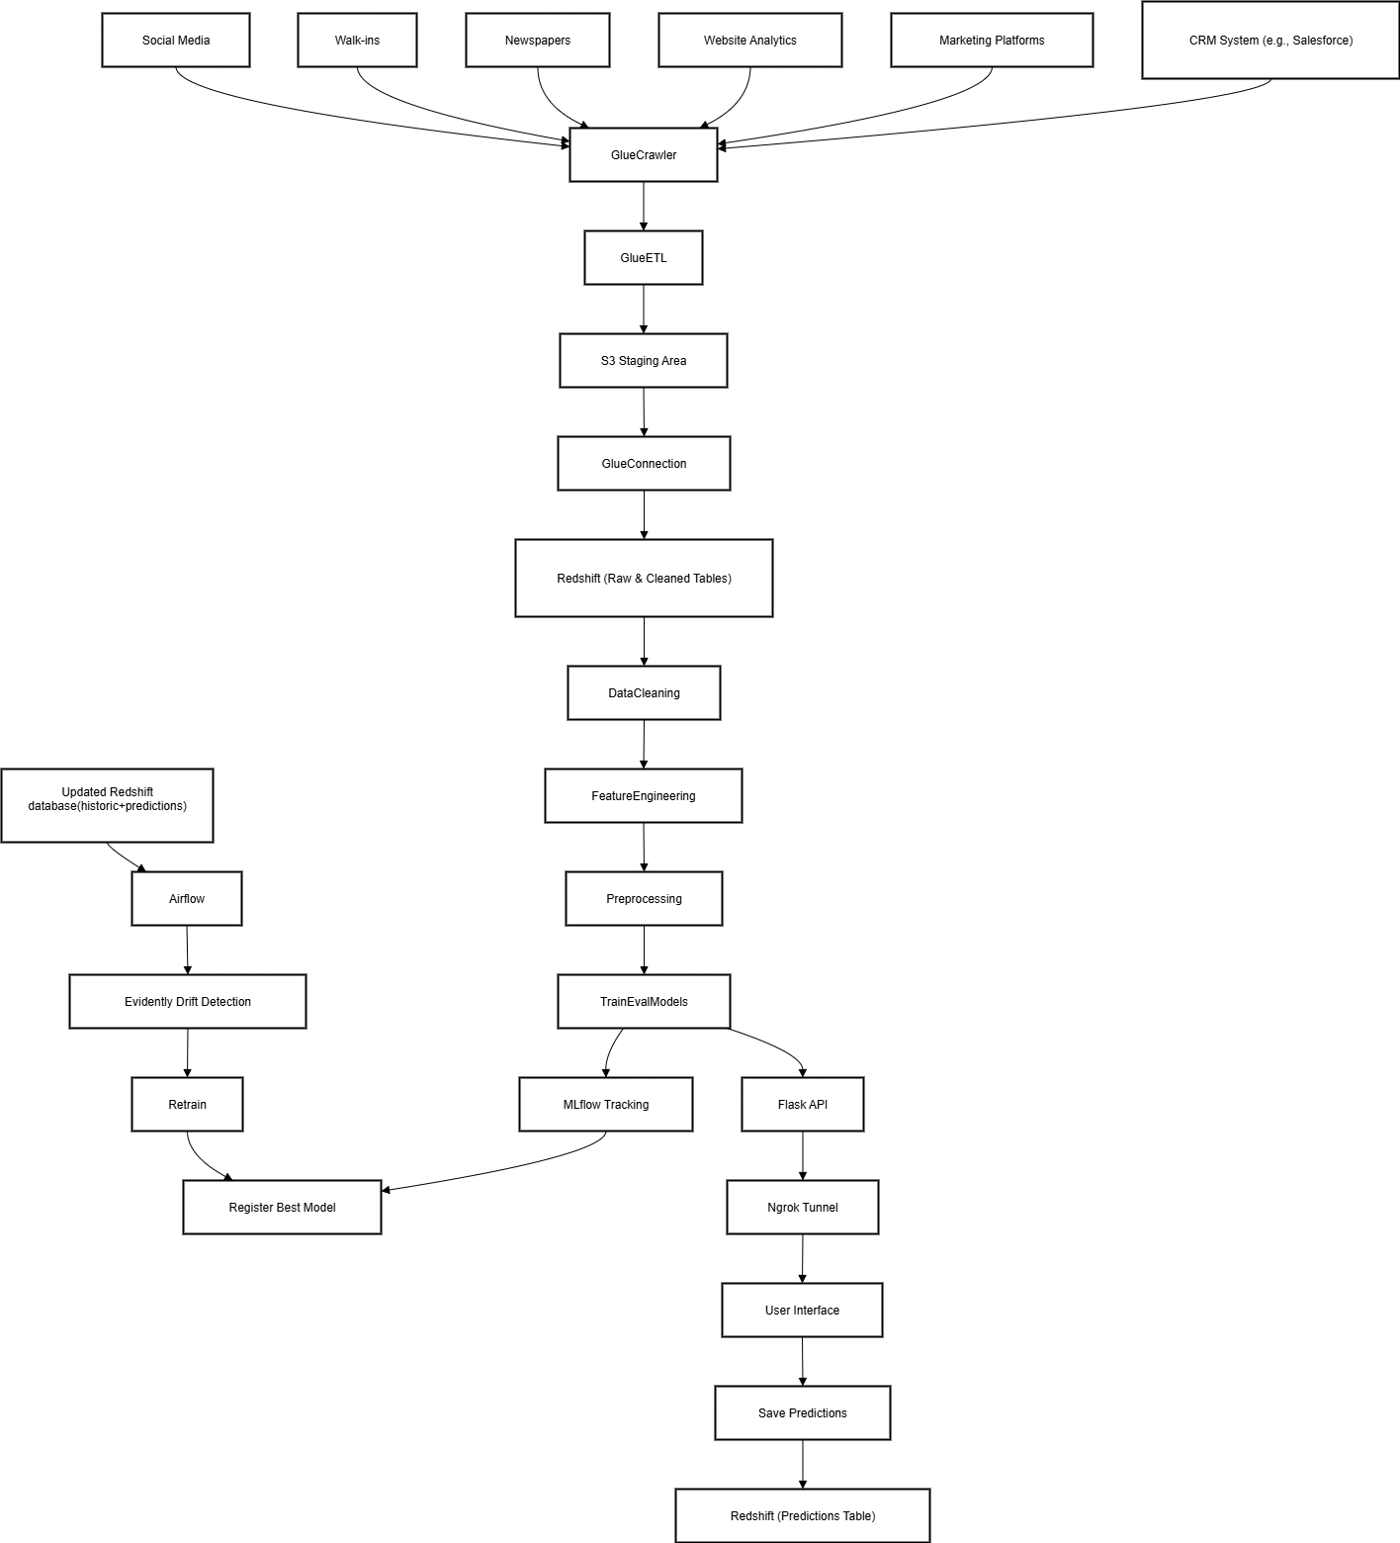

Data Architecture

Slide 7



Data Preprocessing & Feature Engineering
Thorough data cleaning and preprocessing were crucial to ensure the quality and suitability of the dataset for machine learning. We handled missing values and categorical variables, followed by the engineering of features to enhance the predictive power of our models.
Data Cleaning
Feature Transformation
Feature Engineering
Handling missing values using imputation techniques.
One-hot encoding for categorical variables,label encoding for ordinal data and scaling numerical features using Minmax.
We optimized the feature set by translating categorical values into clear labels, dropping columns with low variance to enhance model performance. This preprocessing step focused on retaining only the most relevant features, simplifying the dataset and boosting model efficiency.
Median for numerical features and mode for categorical features

Slide 8
Model Building & Training
We explored various classification models to identify the most effective solution for lead conversion prediction. Through rigorous training and hyperparameter tuning, we aimed to achieve optimal performance. RandomForest emerged as the superior model, demonstrating robust capabilities across key evaluation metrics.
Models Explored
Training Approach
Logistic Regression: Baseline for binary classification.
Split data into training, validation, and test sets.
Decision Trees: Understand feature importance.
Cross-validation to prevent overfitting.
Random Forest: Ensemble method for improved accuracy.
Hyperparameter tuning using GridSearchCV/RandomizedSearchCV.
Gradient Boosting (XGBoost): Advanced ensemble for high performance.
Focus on balancing precision and recall due to imbalanced dataset.

Slide 9






Model Evaluation & Performance
Our RandomForest model performed best, showing high accuracy, recall, and F1-score. This means it's good at finding and predicting which leads will turn into customers, giving sales teams a reliable tool.
High Accuracy
Robust Recall
Balanced F1-Score
The model demonstrated exceptional accuracy in distinguishing between converting and non-converting leads, providing a strong foundation for reliable predictions.
Crucially for sales, the model achieved high recall, meaning it successfully identified a large percentage of actual converting leads, reducing the chances of missing high-potential prospects.
The impressive F1-score indicates a strong balance between precision and recall, ensuring that the model is not only identifying many true positives but also minimizing false alarms, making it highly practical for lead prioritization.
Beyond overall performance, our analysis pinpointed the most influential features driving lead conversion. Understanding these factors provides clear actionable insights for refining sales strategies and improving lead nurturing processes.
Engagement Metrics
Lead Origin & Source
Specific Lead Tags
Higher time spent on the website, frequency of visits, and recent activities are strong indicators of a lead's interest and likelihood to convert. This highlights the importance of timely follow-ups and engaging content.
The initial channel through which a lead was acquired (e.g., specific campaigns, referrals, organic search) significantly impacts conversion probability. This allows for optimization of marketing spend and lead generation efforts.
Categorical labels assigned to leads, reflecting their specific interests or behaviours, proved to be highly predictive. These tags, often derived from form submissions or behavioural data, can segment leads for tailored approaches.
These insights empower sales teams to not only prioritize leads based on predictive scores but also to understand the underlying reasons for potential conversion, enabling more personalized and effective engagement strategies.

Slide 10
Conclusion & Next Steps
The predictive lead conversion model represents a significant step towards data-driven sales strategies. By reducing effort on low-quality leads and enhancing ROI, businesses can achieve smarter, more efficient sales operations. Integration into existing CRM systems will automate and optimise lead handling, leading to a tangible competitive advantage.
A/B Testing & Refinement
CRM Integration
Continuously monitor model performance and retrain with new data for ongoing improvement.
Seamlessly embed the model into sales workflows for automated lead scoring and prioritisation.
Scalability
Feature Expansion
Ensure the solution scales to accommodate growing lead volumes and evolving business needs.
Explore additional data sources (e.g., social media activity, macroeconomic factors) to further enhance predictive accuracy.

Slide 11
🔍 Business Insights for Lead Conversion Optimization
1. 🎯 Lead Quality Drives Conversion51.59% of data for Lead Quality is missing — a major gap in understanding which leads are promising.Business Insight: Invest in improving the lead scoring process. Leads with missing quality scores may be less nurtured or misclassified, which can hurtconversion. ✅ Action: Implement automated scoring based on behavioral signals (e.g., visits, activities) and ensure sales reps consistently label leads.
2. 🧠 Asymmetrique Features Missing ≈ 45%Fields like Asymmetrique Activity/Profile Index/Score all have ~45% missing values, which indicates poor tracking of lead engagement behavior.Business Insight: These metrics are likely system-generated scores of user behavior. Missing values may imply cold leads or incomplete tracking.
✅ Action: Strengthen integration between marketing tools and CRM to auto-capture user interaction for every touchpoint.
3. 🏷️ High Missing Rate in ‘Tags’ (36%)Tags reflect lead-specific statuses or sales team notes (e.g., “Will revert after reading the email”).Business Insight: Missing tags signal inconsistent follow-ups or lack of sales notes — a gap in personalization.
✅ Action: Enforce mandatory tagging during each lead interaction to enable contextual re-engagement and better funnel segmentation.
4. 👤 User Personalization Fields Missing (15-30%)Fields like:Lead Profile (29.32%)What matters most... (29.32%)Occupation (29.11%)Country, City, Specialization, How did you hear...Business Insight: These are crucial for targeted marketing and personalized course recommendations. Missing values reduce the effectiveness of segmentation and campaign design.
✅ Action: Make these fields mandatory on forms or progressively collect this info during nurturing workflows.
🚀 Recommended Improvements:
Improve Data Capture:
Make Lead Quality, Tags, and Profile Index mandatory or auto-filled during entry
Simplify Forms:
Remove rarely used fields (e.g., Newspaper, Magazine) or group them under “Others”
Educate Sales Team:
Emphasize the importance of filling key lead fields
Track Source Reliability:
Some sources (e.g., Search, Forums) have 100% missing — audit and clean these
Implement Real-time Validation:
Trigger form alerts for missing critical fields

